Slide 1
Genetic Programming
Chapter 6

Slide 2
GP quick overview
Developed: USA in the 1990’s
Early names: J. Koza
Typically applied to:
  machine learning tasks (prediction, classification…)
Attributed features:
  competes with neural nets and alike
  needs huge populations (thousands)
  slow
Special:
  non-linear chromosomes: trees, graphs
  mutation possible but not necessary (disputed!)

Slide 3
Introductory example: credit scoring
Bank wants to distinguish good from bad loan applicants
Model needed that matches historical data
ID | No of children | Salary | Marital status | OK?
ID-1 | 2 | 45000 | Married | 0
ID-2 | 0 | 30000 | Single | 1
ID-3 | 1 | 40000 | Divorced | 1
…

Slide 4
Introductory example: credit scoring
A possible model:
IF (NOC = 2) AND (S > 80000) THEN good ELSE bad
In general:
IF formula THEN good ELSE bad
Only unknown is the right formula, hence
Our search space (phenotypes) is the set of formulas
Natural fitness of a formula: percentage of well classified cases of the model it stands for
Natural representation of formulas (genotypes) is: parse trees

Slide 5
Introductory example: credit scoring
IF (NOC = 2) AND (S > 80000) THEN good ELSE bad
can be represented by the following tree
AND
=
>
NOC
2
S
80000

Slide 6
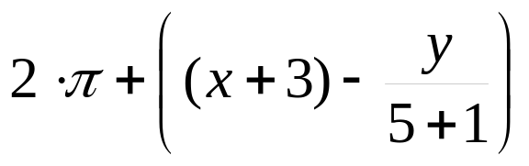
Tree based representation
Trees are a universal form, e.g. consider
Arithmetic formula
Logical formula
Program
(x ∧ true) → (( x ∨ y ) ∨ (z ↔ (x ∧ y)))
i =1;
while (i < 20)
{
i = i +1
}

Slide 7
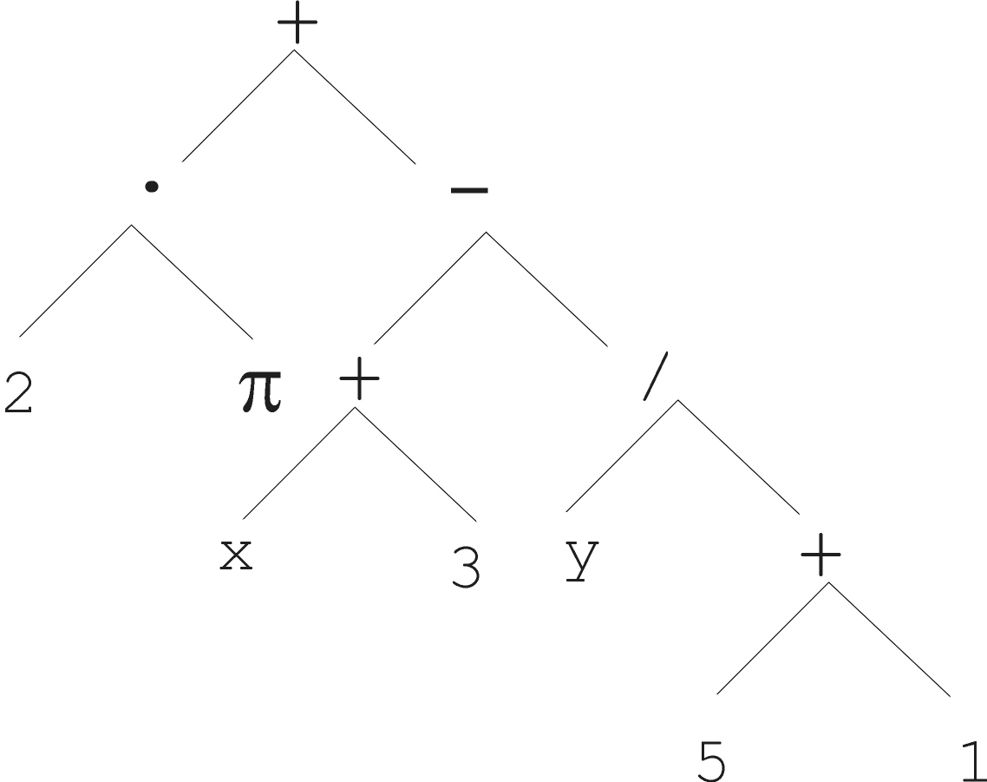
Tree based representation

Slide 8
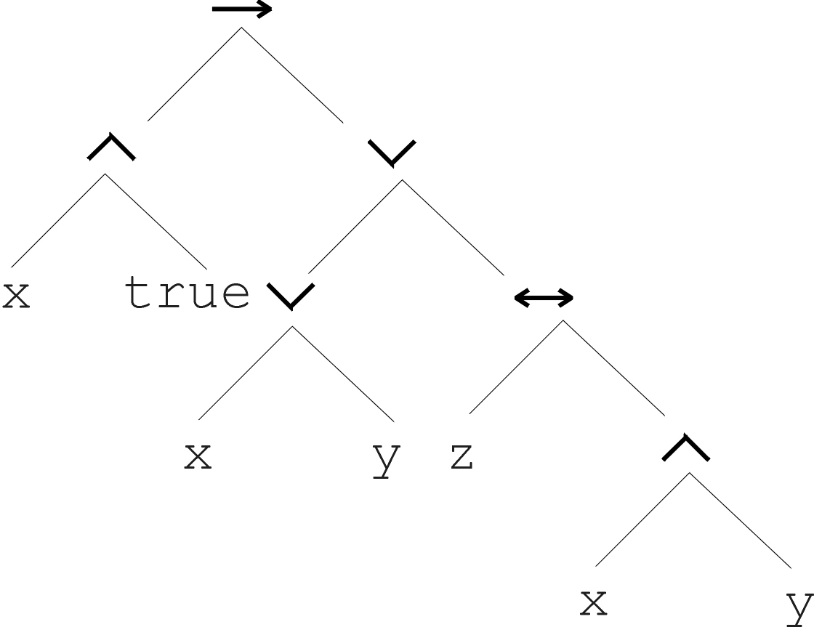
Tree based representation
(x ∧ true) → (( x ∨ y ) ∨ (z ↔ (x ∧ y)))

Slide 9
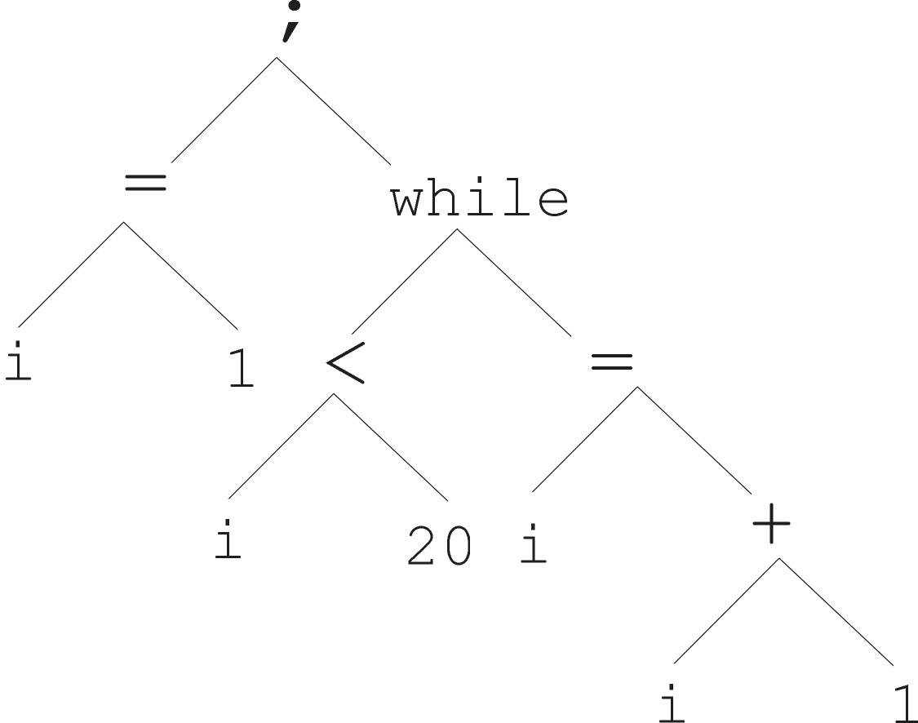
Tree based representation
i =1;
while (i < 20)
{
i = i +1
}

Slide 10
Tree based representation
In GA, ES, EP chromosomes are linear structures (bit strings, integer string, real-valued vectors, permutations)
Tree shaped chromosomes are non-linear structures
In GA, ES, EP the size of the chromosomes is fixed
Trees in GP may vary in depth and width

Slide 11
Tree based representation
Symbolic expressions can be defined by
  Terminal set T
  Function set F (with the arities of function symbols)
Adopting the following general recursive definition:
  Every t ∈ T is a correct expression
  f(e₁, …, e_{n}) is a correct expression if f ∈ F, arity(f)=n and e₁, …, e_{n} are correct expressions
  There are no other forms of correct expressions
In general, expressions in GP are not typed (closure property: any f ∈ F can take any g ∈ F as argument)

Slide 12
Offspring creation scheme
Compare
GA scheme using crossover AND mutation sequentially (be it probabilistically)
GP scheme using crossover OR mutation (chosen probabilistically)

Slide 13
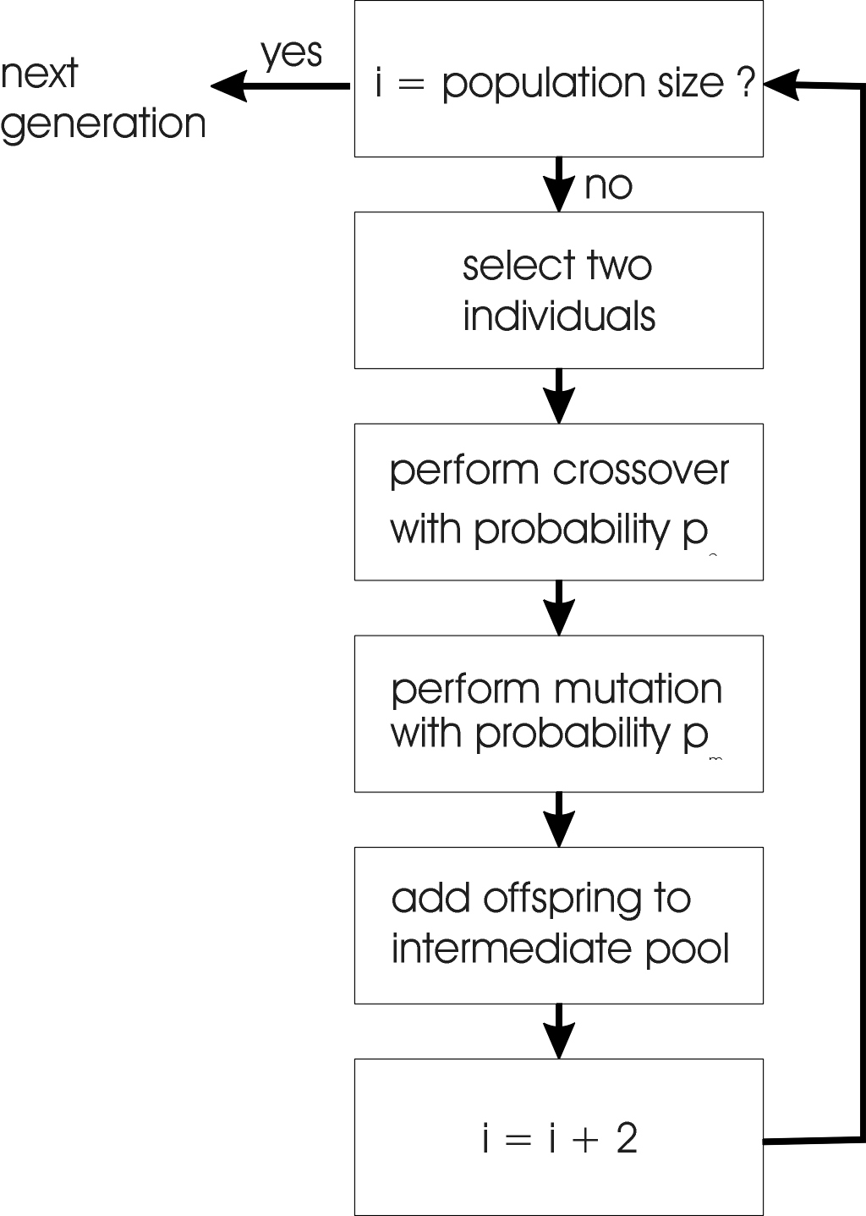
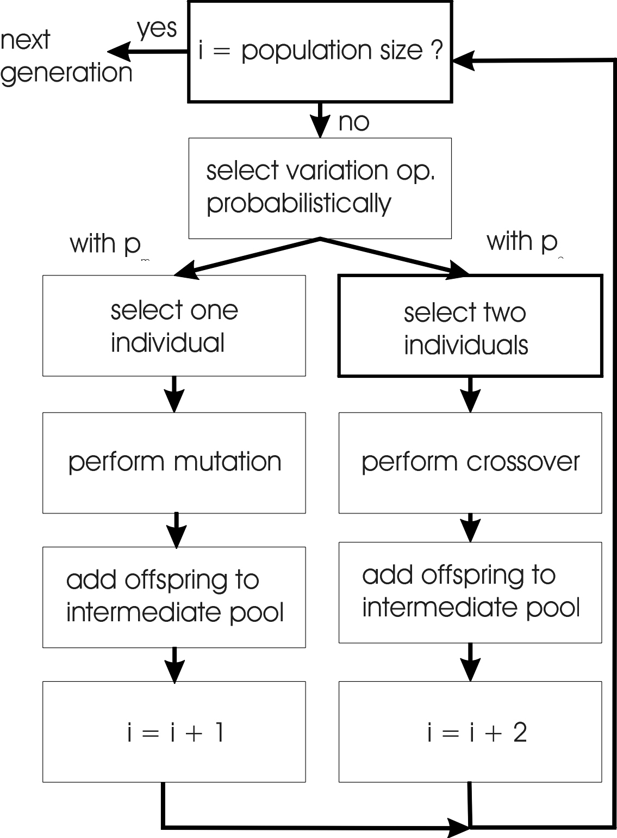
GA flowchart
GP flowchart

Slide 14
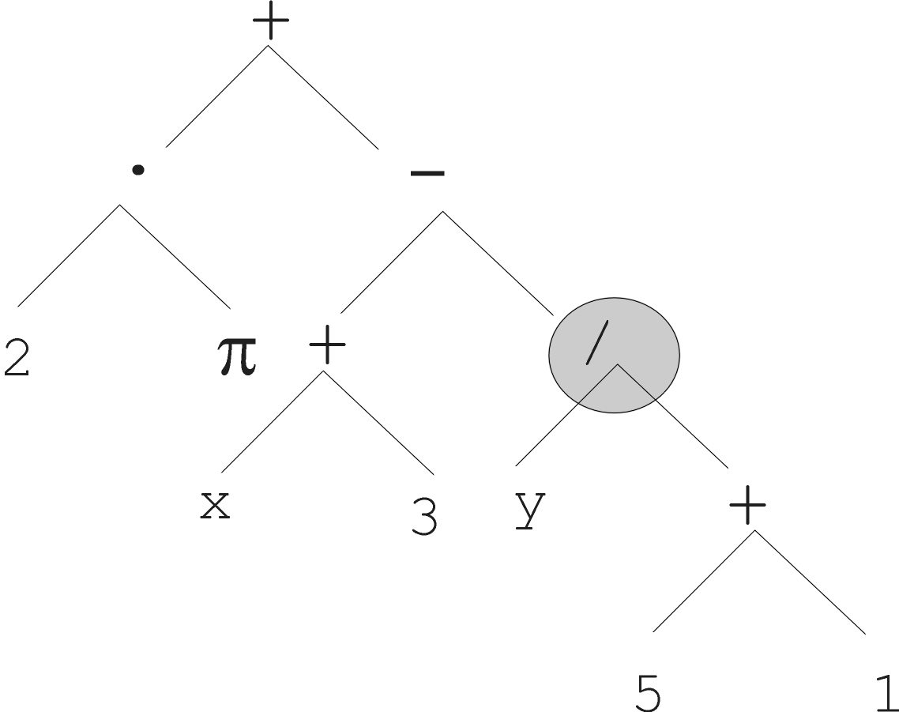
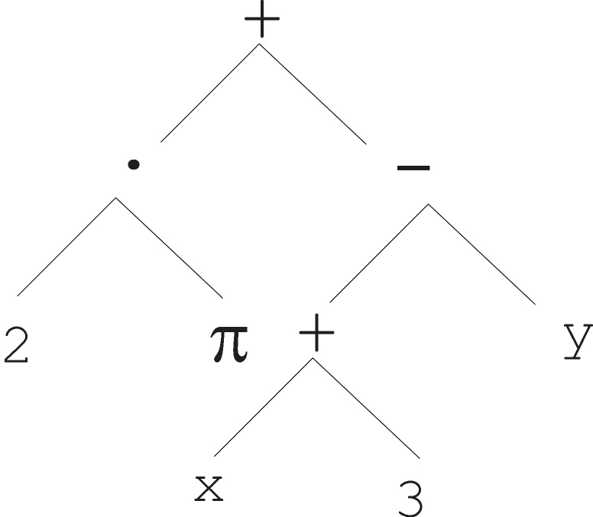
Mutation
Most common mutation: replace randomly chosen subtree by randomly generated tree

Slide 15
Mutation cont’d
Mutation has two parameters:
  Probability p_{m} to choose mutation vs. recombination
  Probability to chose an internal point as the root of the subtree to be replaced
Remarkably p_{m} is advised to be 0 (Koza’92) or very small, like 0.05 (Banzhaf et al. ’98)
The size of the child can exceed the size of the parent

Slide 16
Recombination
Most common recombination: exchange two randomly chosen subtrees among the parents
Recombination has two parameters:
  Probability p_{c} to choose recombination vs. mutation
  Probability to chose an internal point within each parent as crossover point
The size of offspring can exceed that of the parents

Slide 17
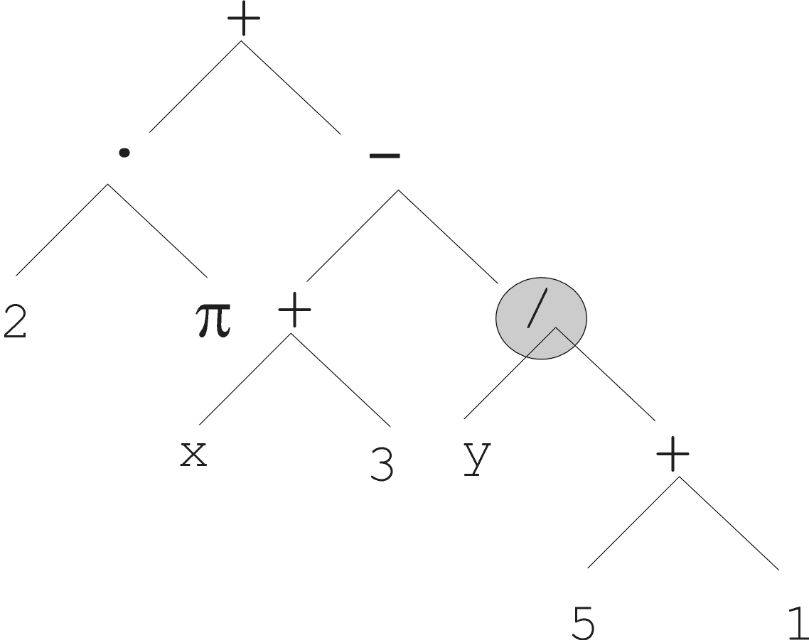
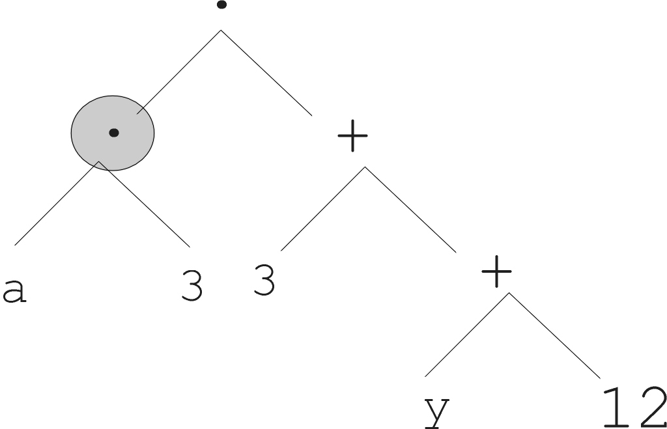
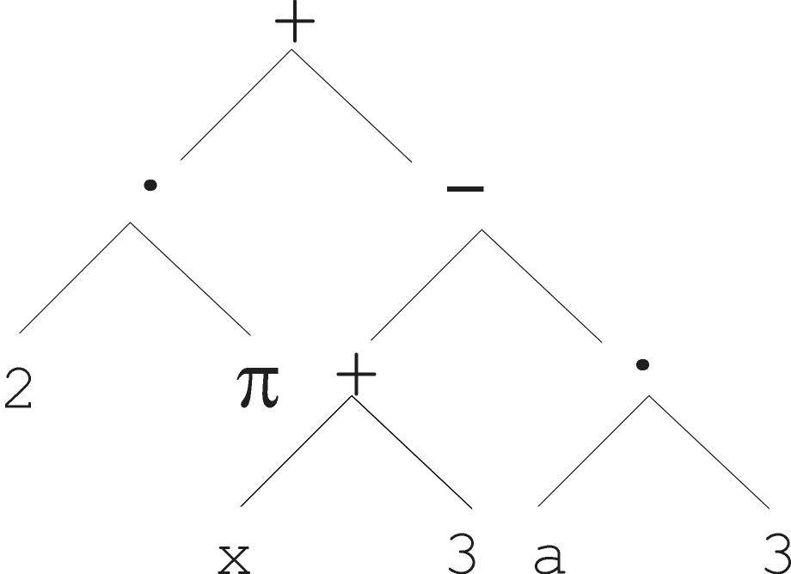
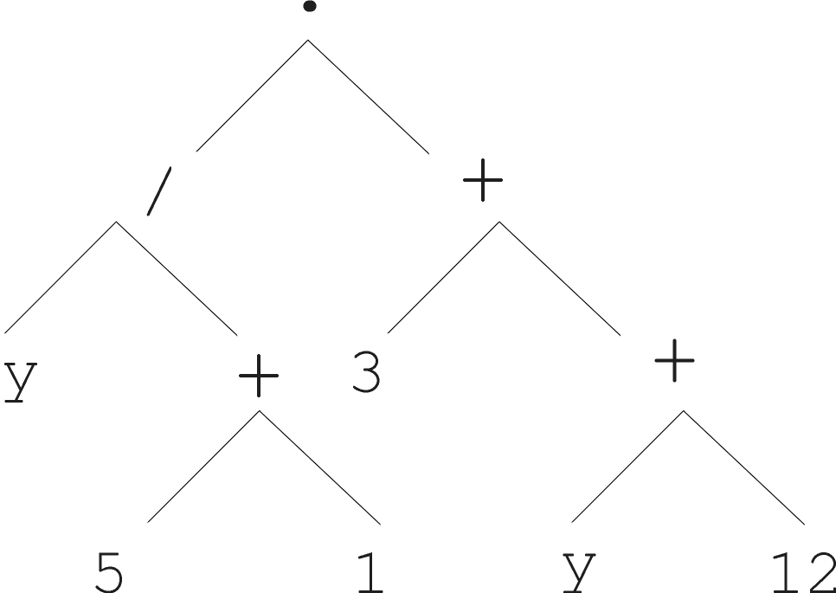
Parent 1
Parent 2
Child 1
Child 2

Slide 18
Selection
Parent selection typically fitness proportionate
Over-selection in very large populations
  rank population by fitness and divide it into two groups:
  group 1: best x% of population, group 2 other (100-x)%
  80% of selection operations chooses from group 1, 20% from group 2
  for pop. size = 1000, 2000, 4000, 8000 x = 32%, 16%, 8%, 4%
  motivation: to increase efficiency, %’s come from rule of thumb
Survivor selection:
  Typical: generational scheme (thus none)
  Recently steady-state is becoming popular for its elitism

